Slide 1
Module-2: Supervised Learning:
Regression: Linear regression, Polynomial regression, Model evaluation metrics: MAE, MSE, RMSE.
Classification: Logistic regression, K-Nearest Neighbors (KNN), Decision Trees and Random Forests, Model evaluation metrics: Accuracy, precision, recall, F1-score, ROC-AUC.
Model Training and Evaluation: Train-test split and cross-validation, Hyper parameter tuning using GridSearchCV, Overfitting and underfitting.

Slide 2
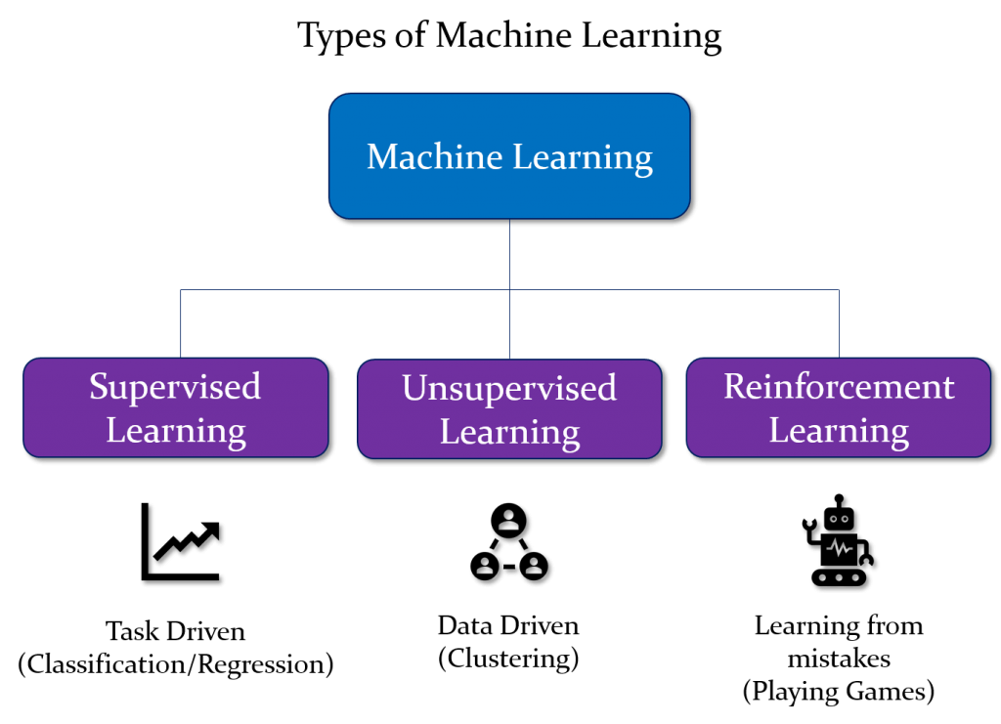

Slide 3
Supervised learning:
Supervised learning is the types of machine learning in which machines are trained using well "labelled" training data, and on basis of that data, machines predict the output. The labelled data means some input data is already tagged or labelled with the correct output.
In supervised learning, the training data provided to the machines work as the supervisor that teaches the machines to predict the output correctly. It applies the same concept as a student learns in the supervision of the teacher. Supervised learning is a process of providing input data as well as correct output data to the machine learning model. The aim of a supervised learning algorithm is to find a mapping function to map the input variable(x) with the output variable(y).
So, the goal of supervised learning is to learn a mapping from inputs to outputs, so that the model can make accurate predictions on new, unseen data.
Note: In supervised learning, models are trained using labelled dataset, where the model learns about each type of data. Once the training process is completed, the model is tested on the basis of test data (a subset of the training set), and then it predicts the output.
https://www.youtube.com/watch?v=olFxW7kdtP8

Slide 4
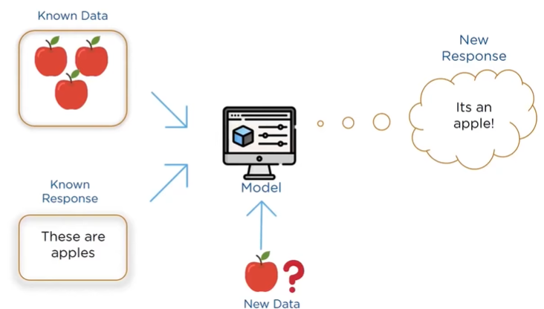

Slide 5
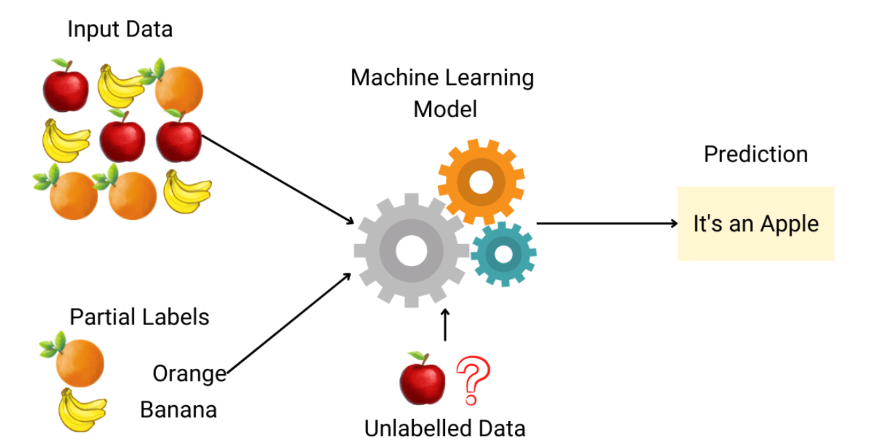

Slide 6
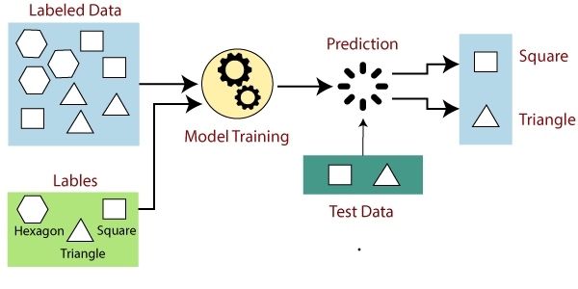

Slide 7
Explanation:
Suppose we have a dataset of different types of shapes which includes square, rectangle, triangle, and Polygon. Now the first step is that we need to train the model for each shape.
If the given shape has four sides, and all the sides are equal, then it will be labelled as a Square.
If the given shape has three sides, then it will be labelled as a triangle.
If the given shape has six equal sides then it will be labelled as hexagon.
Now, after training, we test our model using the test set, and the task of the model is to identify the shape. The machine is already trained on all types of shapes, and when it finds a new shape, it classifies the shape on the bases of a number of sides, and predicts the output

Slide 8
Example-3: Predicting Housing Prices
Let's consider a common example of supervised learning: predicting housing prices based on various features.
Input Features:
Size of the house (in square feet)
Number of bedrooms
Number of bathrooms
Distance to the city center
Presence of nearby amenities (e.g., schools, parks)
Labels (Outputs):
Sale price of the house
Training Dataset:
A dataset containing historical examples of houses with features and their corresponding sale prices.
Model:
A supervised learning algorithm, such as linear regression, is chosen to learn the relationship between the input features and the sale prices.

Slide 9
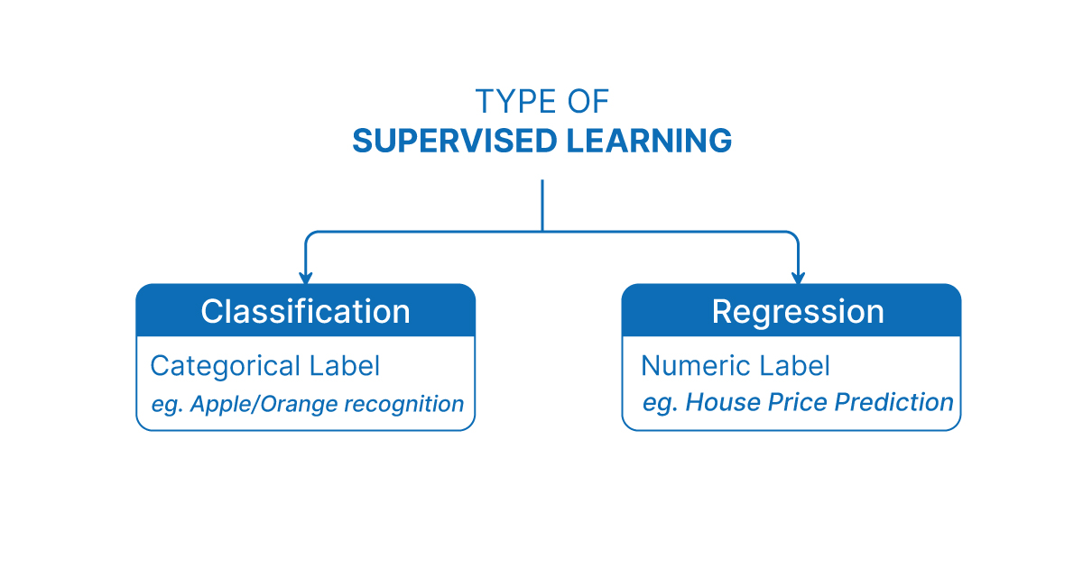

Slide 10
Regression :
Regression is a type of supervised machine learning task where the goal is to predict a continuous numerical value or outcome based on input features.
Regression is a type of supervised machine learning where algorithms learn from the data to predict continuous values such as sales, salary, weight, or temperature.
What mean by continuous numerical value :
In machine learning, the term continuous values refers to numeric values that can take any value within a range, not just fixed or distinct values.
These are real numbers (decimals or integers) that can vary smoothly over a range, as opposed to categorical values, which are fixed labels or classes (like "Yes"/"No", or "Red"/"Green").

Slide 11
Note: In the context of regression in machine learning, a continuous numerical value refers to an outcome or target variable that can take on an infinite number of values within a specific range. In case of predicting a person's age, age is considered a continuous numerical value because it can theoretically take on any value within a certain range (for example, from 0 to 100+ years). There are no gaps or intervals between possible ages, and age can be expressed as a decimal or fraction if necessary (e.g., 25.5 years).
It is a variable that can have any real number value, and there are no distinct categories or classes. The term "continuous" implies that the variable can vary over a continuous range, and there are no gaps or interruptions in the possible values it can take. In contrast, in a classification task, the target variable would be a discrete set of categories or classes.
Note:
Here, “discrete set of categories or classes" refers to a set of distinct and separate values that a variable can take

Slide 12
🔁 Regression Contrast with Classification:
In classification, the outputs are discrete categories, like:
"Pass" or "Fail"
"Spam" or "Not Spam"
"Dog", "Cat", or "Bird"
Whereas in regression, the goal is to predict a number, like:
88.4 marks
₹56,789.25 income

Slide 13
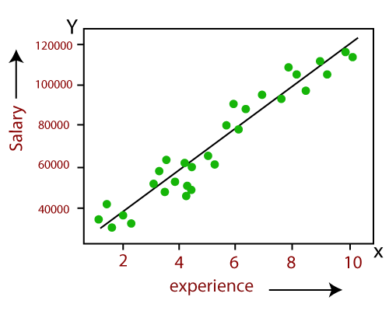
Example:
Linear Regression:
Predicting the salary of an employee on the basis of the year of experience.

Slide 14
Types of Regression:
There are several types of regression techniques, each suited for different kinds of data and relationships between variables.
Linear Regression (Formula: Y = mX + c)
Multiple Linear Regression (Formula: Y = b0 + b1X1 + b2X2 + ... + bnXn)
Polynomial Regression (Formula: Y = b0 + b1X + b2X² + ... + bnXⁿ)
Logistic Regression (Technically Classification)

Slide 15

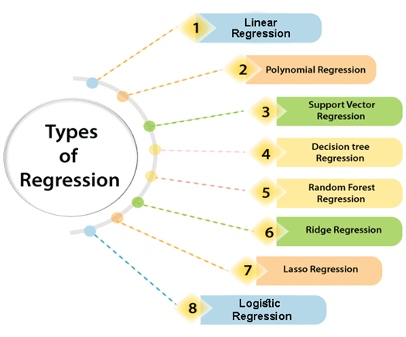

Slide 16
Linear regression:
As the name indicates, simple linear regression is the simplest regression model which involves only one independent variable or predictor and only one Dependent Variable or the Response Variable.
Linear Regression is a supervised learning algorithm used to predict a continuous target variable (Y) based on the value of an independent variable (X), assuming a linear relationship between them.
This model assumes a linear relationship between the dependent variable and the predictor variable i.e, The relationship between Dependent and Independent Variable is Linear. Here Linear means if the value of independent variable increases or decreases then the value of Dependent variable will increase or decreases for sure.

Slide 17
Formula:
Note:
When we are trying to predict a categorical or nominal variable, the problem is known as a classification problem. A classification problem is one where the output variable is a category such as ‘red’ or ‘blue’ or ‘malignant tumour’ or ‘benign tumour’ etc. Whereas when we are trying to predict a numerical variable such as ‘price’, ‘weight’, etc. the problem falls under the category of regression.
Where:
Y = Predicted/Target variable (e.g., Salary)
X = Independent/Input variable (e.g., Years of Experience)
m = Slope (how much Y changes with change in X)
c = Intercept (value of Y when X = 0)
Y = mX + c

Slide 18
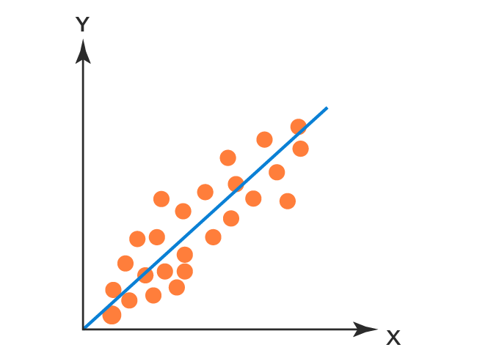
Working of Simple Linear Regression:
The Working of Simple Linear Regression is very Simple that it will draw a straight line in a 2D Plane which is called Best Fit Line.
So our aim is to find the Best Fit Line with minimal Error.
Let’s Take an Example of Height and Weight such that the Problem is to Find a Height of a Person given the Weight.
Note: Best Fit Line is draws based on the Slope of the Line
Best Fit Line
Height
Weight
https://www.youtube.com/watch?v=jerPVDaHbEA

Slide 19
🔢 Example Problem: Predicting Salary
🎯 Goal: Predict the salary of a person based on their years of experience.
🧾 Dataset (Sample):
Here, we want to predict salary for someone with, say, 6 years of experience.
Years of Experience (X) | Salary (Y) in ₹
1 | 3,00,000
2 | 3,50,000
3 | 4,00,000
4 | 4,50,000
5 | 5,00,000

Slide 20
📉 Step-by-Step Process:
Step 1: Visualize Data (Described)
If you plot this data on a graph:
X-axis = Years of Experience
Y-axis = Salary
You will notice a straight-line pattern, which indicates a linear relationship.

Slide 21
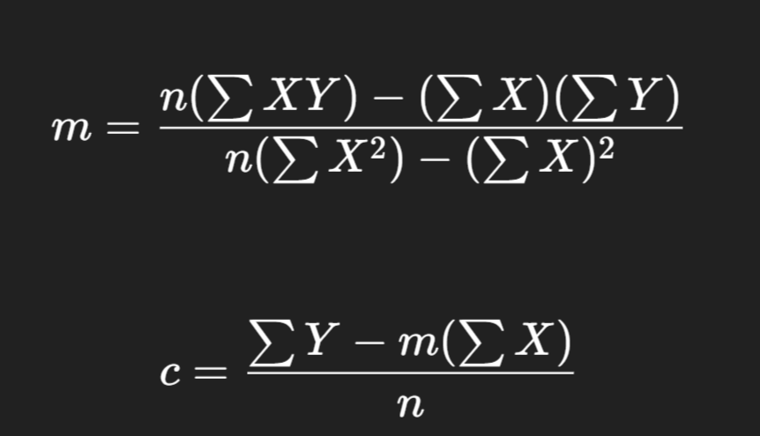
Step 2: Calculate Line of Best Fit
We find values of m (slope) and c (intercept) using a method called least squares, which minimizes the sum of squared differences between actual and predicted salaries.
📌 Slope (m) Formula:
📌 Intercept (c) Formula:

Slide 22
✅ Add Helper Columns — XY and X²
X | Y | X × Y | X²
1 | 300000 | 300000 | 1
2 | 350000 | 700000 | 4
3 | 400000 | 1200000 | 9
4 | 450000 | 1800000 | 16
5 | 500000 | 2500000 | 25

Slide 23
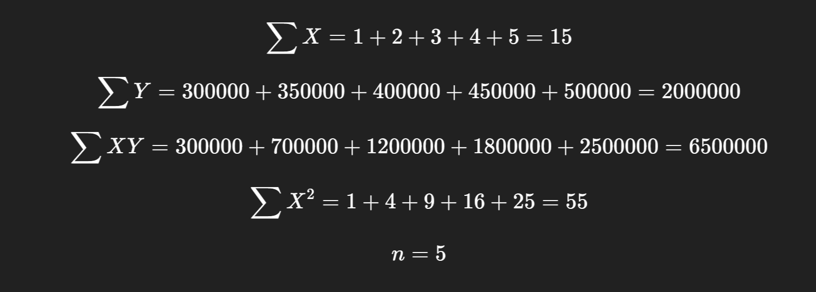
✅ Calculate Summations

Slide 24
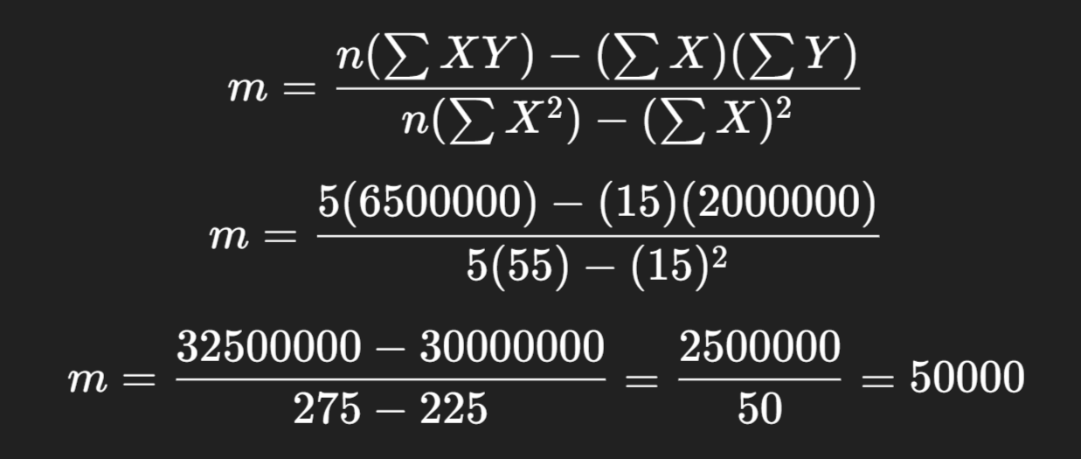
✅ Apply the Slope (m) Formula:

Slide 25
✅ Slope (m) = 50,000
The slope represents how much the salary increases for each additional year of experience.
📘 In Simple Terms:
Every time a person gains 1 more year of experience, their salary increases by ₹50,000 — according to the pattern observed in the dataset.

Slide 26
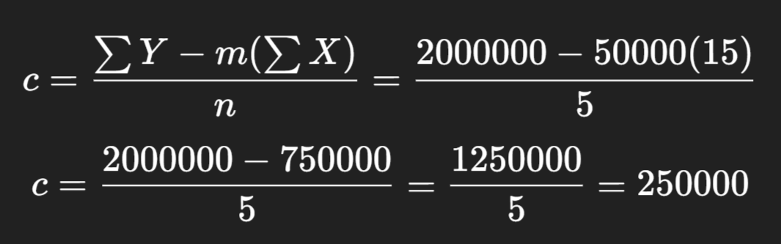
✅ Apply the Intercept (c) Formula

Slide 27
✅ Intercept (c) = ₹2,50,000:
The intercept is the value of Y (salary) when X (years of experience) = 0.
📘 In Simple Words:
Even if a person has 0 years of experience, the model predicts their starting salary will be ₹2,50,000.

Slide 28

✅ Final Linear Regression Equation:

Slide 29
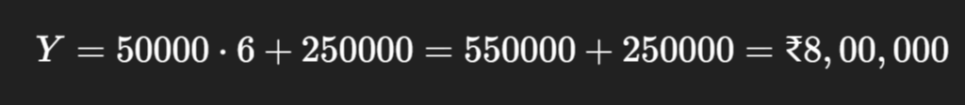
📌 Final Prediction Example:
If a person has 6 years of experience, predicted salary:

Slide 30
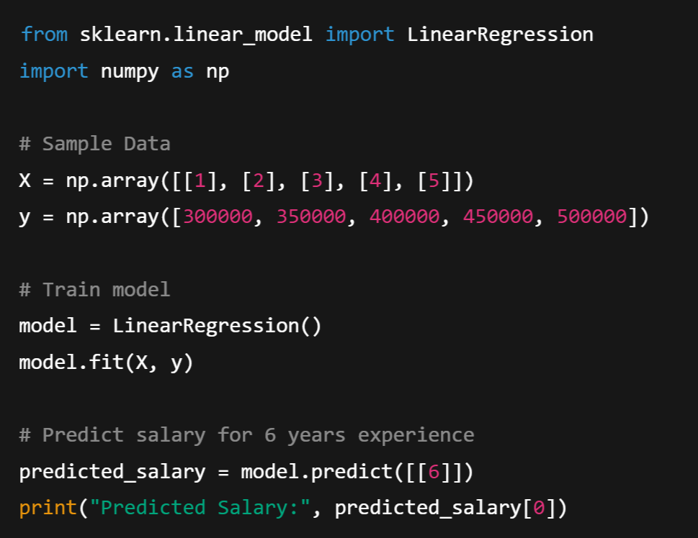
🧪 Python Example
(Using scikit-learn)

Slide 31

Output:

Slide 32
📌 Advantages of Linear Regression
Easy to implement and interpret
Fast to train
Works well with linearly correlated data
Predictive Power
⚠️ Limitations
Assumes linearity or Linear Relationship
Sensitive to outliers
Limited to Numeric, Continuous Data
Doesn’t perform well with non-linear or highly complex relationships

Slide 33
Polynomial Regression:
Polynomial regression model is the extension of the simple linear model.
Polynomial Regression is a type of supervised machine learning algorithm used to predict a continuous dependent variable (Y) based on the value of one or more independent variables (X) — but with a twist:
Unlike Linear Regression, which fits a straight line, Polynomial Regression fits a curved line to the data.

Slide 34
Why Polynomial Regression?
A simple linear regression algorithm only works when the relationship between the data is linear. But suppose we have non-linear data, then linear regression will not be able to draw a best-fit line. Simple regression analysis fails in such conditions. Consider the below diagram, which has a non-linear relationship, and you can see the linear regression results on it, which does not perform well, meaning it does not come close to reality. Hence, we introduce polynomial regression to overcome this problem, which helps identify the curvilinear relationship between independent and dependent variables.
For example:
Salary vs Experience: Salary might grow slowly at first, then rise faster.
Growth of plants: Starts slow, then rapid, then slows again.
Product sales: Might peak and then decline.

Slide 35
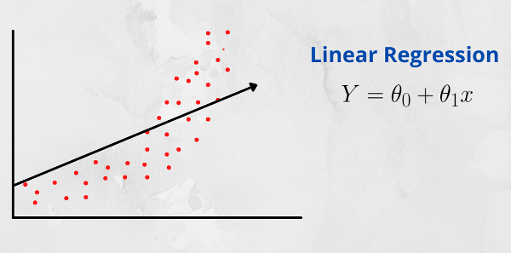
Linear Relationship:
A linear relationship between two variables means that when one variable changes, the other variable changes in a straight-line fashion. In other words, if you were to plot the relationship between the two variables on a graph, the points would form a straight line.
That is, In a linear relationship between two variables, when the value of one variable increases, the value of the other variable also increases if the relationship is positive. Conversely, if the relationship is negative, when the value of one variable increases, the value of the other variable decreases.

Slide 36
Polynomial regression is a form of regression analysis in machine learning (ML) where the relationship between the independent variable X and the dependent variable Y is modeled as an n-degree polynomial. Unlike simple linear regression, which fits a straight line to the data, polynomial regression can capture more complex relationships between variables by introducing polynomial terms.
The general form of a polynomial regression model with one independent variable X can be expressed as:
Polynomial with Degree or Order n:
y = b0 + b1X + b2X² + ....... + bnX^{n} + ε
where:
y is the dependent variable,
x is the independent variable,
b0, b1, b2,…………..bn​ are the coefficients,
n is the l,
ε is the error term.

Slide 37
Polynomial Terms:
Polynomial terms refer to mathematical expressions involving variables raised to powers and multiplied by coefficients. In the context of polynomial regression or polynomial functions, these terms are used to model relationships between variables that are not linear.
A polynomial term typically takes the form bx^{n},
where:
b is a coefficient (a constant multiplier),
x is the variable,
n is a non-negative integer representing the degree of the term (the exponent to which the variable is raised).

Slide 38
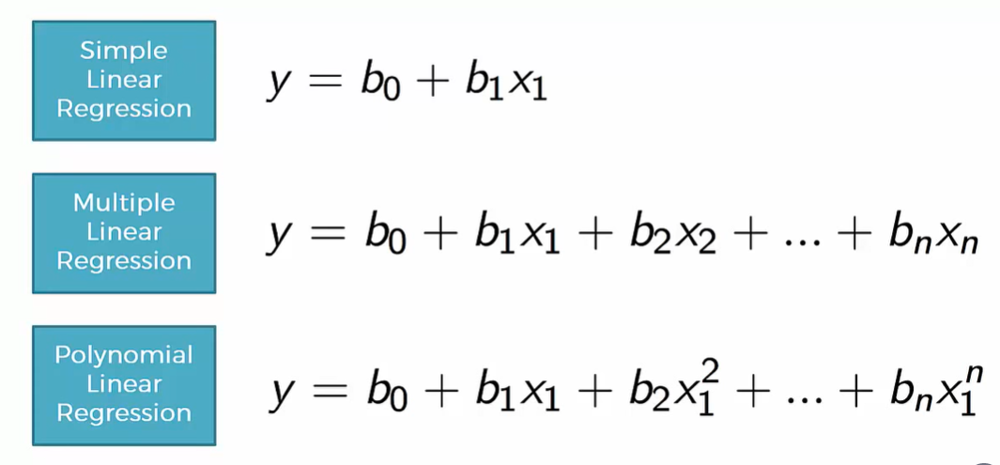

Slide 39
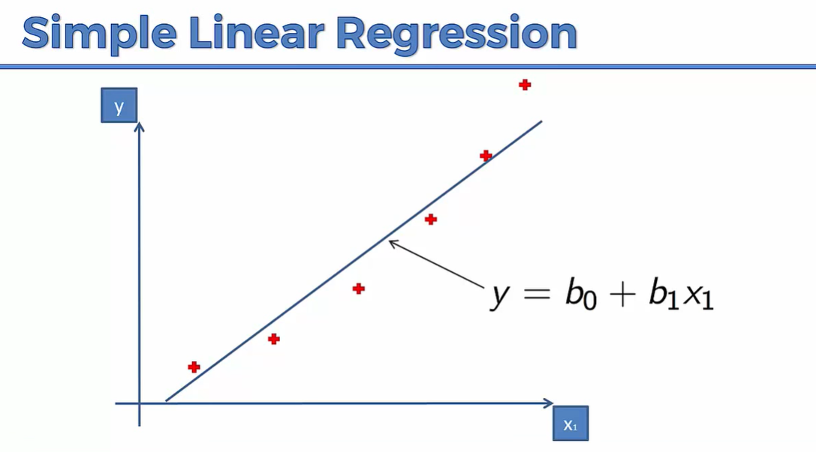

Slide 40
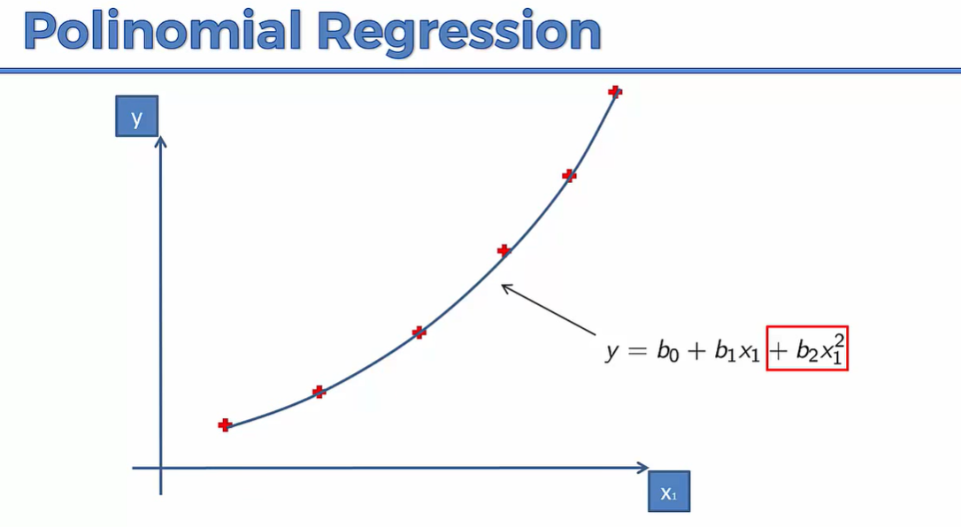

Slide 41
🔢 Example Problem: Predicting Salary
🎯 Goal: Predict the salary of a person based on their years of experience using Polynomial Regression.
🧾 Dataset (Sample):
Here, we want to predict salary for someone with, say, 6 years of experience.
Years of Experience (X) | Salary (Y) in ₹
1 | 3,00,000
2 | 3,50,000
3 | 4,30,000
4 | 5,60,000
5 | 9,00,000

Slide 42
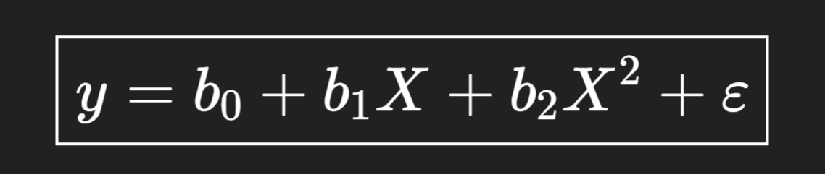
🔍 Observations:
Salary increases slowly at first, then rapidly — this is non-linear growth.
A straight line (linear regression) would not capture this pattern well.
So, we apply polynomial regression with a curve like:
Here, we use a quadratic model (degree 2). You can increase degree (like X³, X⁴...) for more complex curves, but we’ll keep it simple.

Slide 43
✅ Step 1: Compute required columns
X | Y | X² | X³ | X⁴ | XY | X²Y
1 | 300000 | 1 | 1 | 1 | 300000 | 300000
2 | 350000 | 4 | 8 | 16 | 700000 | 1400000
3 | 430000 | 9 | 27 | 81 | 1290000 | 3870000
4 | 560000 | 16 | 64 | 256 | 2240000 | 8960000
5 | 900000 | 25 | 125 | 625 | 4500000 | 22500000

Slide 44
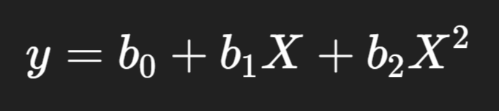
✅ Step 2: Find all totals
∑X=15
∑Y=2540000
∑X2=55
∑X3=225
∑X4=979
∑XY=9030000
∑X2Y=37016000
n=5
We are fitting a quadratic polynomial:

Slide 45
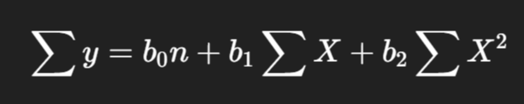
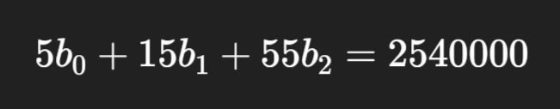
✅ Step 3: Write normal equations:
b0,b1,b2​ are the unknowns (coefficients) we have to find
🧮 Equation 1: Add all the original equations together
We apply summation (∑) on both sides:
This gives the first equation:

Slide 46

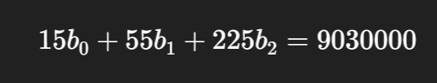
🧮 Equation 2: Multiply each equation by X, then add
We multiply both sides by X and then sum:
This gives:

Slide 47
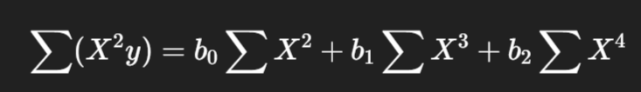

🧮 Equation 3: Multiply each equation by X2, then add
Same idea — multiply both sides by X2, then sum:
Gives:

Slide 48
📌 So why these 3 equations?
Because we’re solving for 3 unknowns:
b0: intercept.
b1: controls slope (linear effect)
b2: controls curve (quadratic effect)
The quadratic effect refers to a specific type of relationship between variables, typically in a mathematical, statistical, or scientific context, where the change in the dependent variable is proportional to the square of the independent variable.
These equations are called the normal equations — and they help the computer find the best-fitting curve behind the scenes.

Slide 49
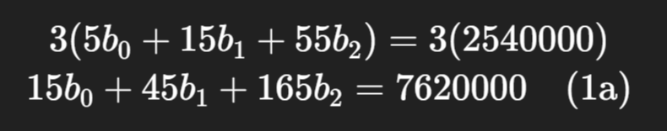
✅ Step 4: Solve the system (simplify the 3 equation):
Eliminate one variable from two equations:
Let’s eliminate b₀ from (1) and (2).
Multiply equation (1) by 3:

Slide 50
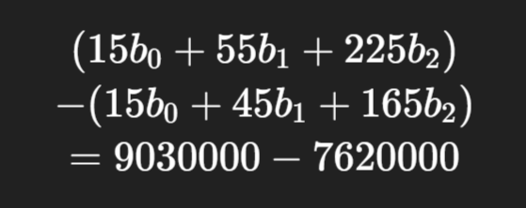

Now subtract (1a) from (2):
Gives:

Slide 51
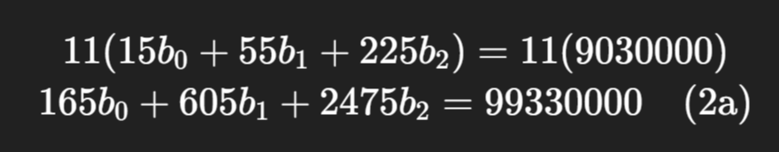
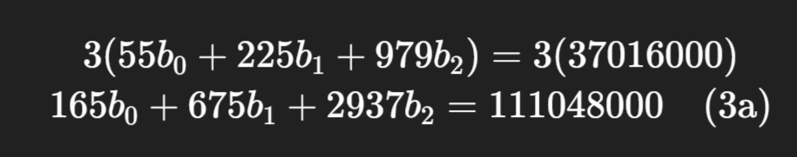
2. Eliminate b₀ from (2) and (3):
Multiply equation (2) by 11:
Multiply equation (3) by 3:

Slide 52
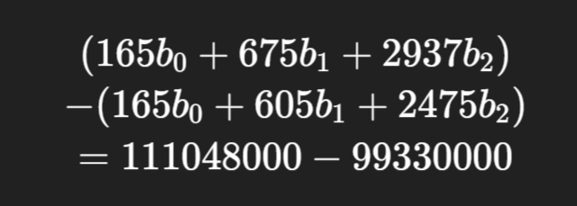

Now subtract (2a) from (3a):
Gives:

Slide 53



3. Solve equations (4) and (5):
Equation (4):
Equation (5):
Let’s multiply (4) by 7:

Slide 54

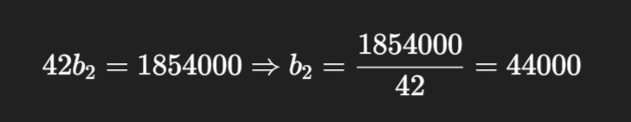
Now subtract (4a) from (5):
Gives:

Slide 55
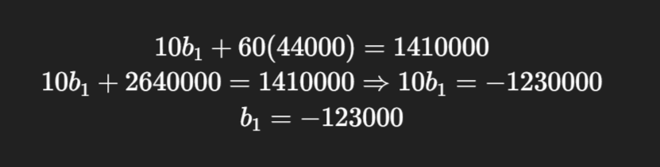
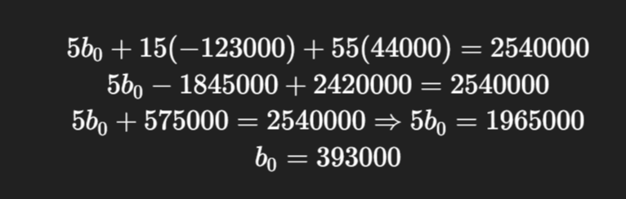
4. Back-substitute to find b₁:
5. Back-substitute to find b₀:

Slide 56
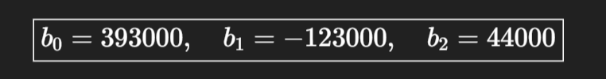

🎉 Final Answer:
✅ Final Equation:

Slide 57
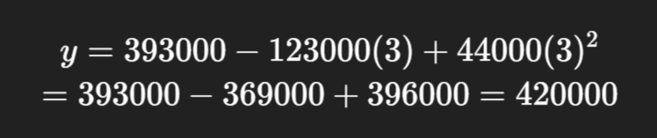
Test the Solution:
For X = 3:
👉 Close to actual value ₹4,30,000

Slide 59
Module-2: Supervised Learning:
Regression: Linear regression, Polynomial regression, Model evaluation metrics: MAE, MSE, RMSE.
Classification: Logistic regression, K-Nearest Neighbors (KNN), Decision Trees and Random Forests, Model evaluation metrics: Accuracy, precision, recall, F1-score, ROC-AUC.
Model Training and Evaluation: Train-test split and cross-validation, Hyper parameter tuning using GridSearchCV, Overfitting and underfitting.

Slide 60
Program-1: Implement and demonstrate the FIND-S algorithm for finding the most specific hypothesis based on a given set of training data samples. Read the training data from a .CSV file.

Slide 61
FIND-S algorithm: (Find-Yes)
FIND-S (Find-Specific) is a simple concept learning algorithm used in Machine Learning. It finds the most specific hypothesis that fits all the positive training examples in the dataset.

Slide 62
✅ What is Concept Learning?
Concept Learning is a type of supervised learning where the goal is to learn a rule or function (called a concept) that classifies examples into positive (Yes) or negative (No) classes.
For example:
Suppose you're trying to learn the concept of "EnjoySport".
You are given a dataset with different weather conditions.
Each row in the data says whether the sport was enjoyed (Yes) or not (No) under those conditions.
Your job is to learn what combination of conditions leads to "EnjoySport = Yes" — this is the "concept".

Slide 63
✅ Hypothesis in Machine Learning? (Theory or Thesis)
A hypothesis is a candidate rule or guess that might describe the concept you're trying to learn.
A hypothesis is a guess or rule that helps predict the output (like Yes/No) given an input.
For example:
Hypothesis= ['Sunny', 'Warm', '?', 'Strong', '?', ‘?’]
This hypothesis says:
"A person will enjoy sport if it is Sunny and Warm and Wind is Strong (rest can be anything)."
This means:
"If the sky is Sunny, and the temperature is Warm, and the wind is Strong — regardless of other factors — then we can say YES to 'EnjoySport'".

Slide 64
🎯 Purpose of FIND-S
Learn from positive examples only (i.e., where the target output is Yes).
Ignore negative examples (No).
Construct the most specific hypothesis that explains all the positive instances.

Slide 65
🧠 How FIND-S Works (Step-by-Step)
Let’s say each example has n attributes, and the goal is to find a hypothesis ‘h’ that is as specific as possible, but consistent with all positive examples.
Step 1: Initialize
Start with the most specific hypothesis possible.
Example: ['∅', '∅', '∅'] or simply the first positive example. (Means the output is Positive)
Step 2: For each training example:
If the example is positive:
Compare it with the current hypothesis.
If any attribute in the hypothesis is different from the current example:
Replace that attribute with ? (which means "any value").
If the example is negative, ignore it.
Step 3: Continue until all examples are processed.
Step 4: The resulting hypothesis is the most specific generalization consistent with the positive examples.

Slide 66
Example Dataset:
Let’s say we’re learning the concept of EnjoySport. Our training dataset looks like this:
Sky | Temp | Humidity | Wind | Water | Forecast | EnjoySport
Sunny | Warm | Normal | Strong | Warm | Same | Yes
Sunny | Warm | High | Strong | Warm | Same | Yes
Rainy | Cold | High | Strong | Warm | Change | No
Sunny | Warm | High | Strong | Cool | Change | Yes

Slide 67
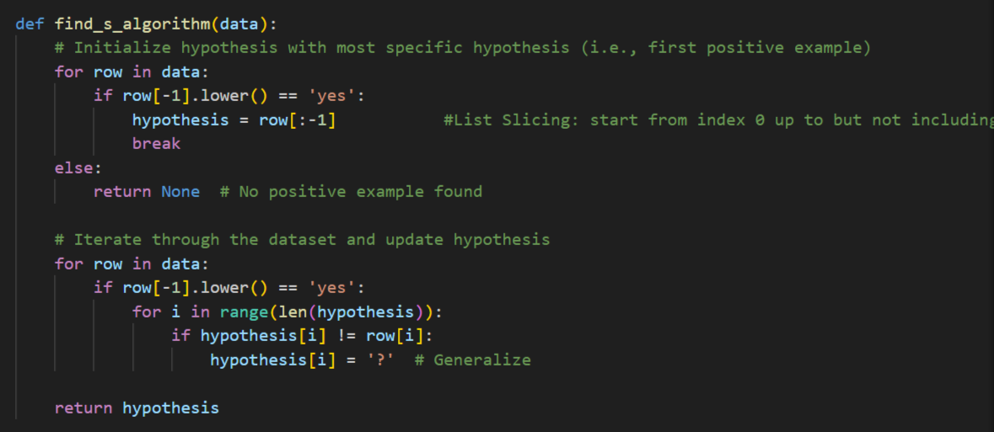

Slide 68
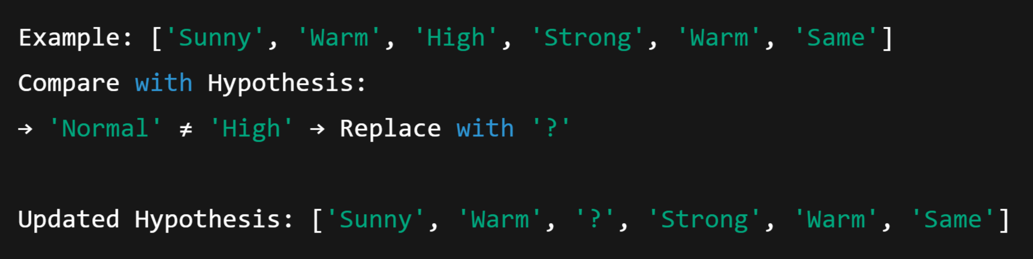
🚀 Step-by-Step Working of FIND-S on Above Data
Start with the first positive example:
Process second positive example:

Slide 69
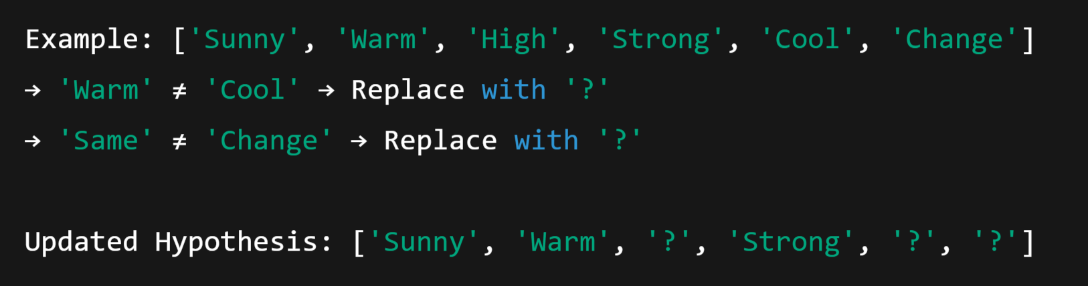
3. Skip third example (it's negative)
4. Process fourth positive example:

Slide 70

🧾 Final Hypothesis:
This means:
Sky must be Sunny
Temp must be Warm
Wind must be Strong
All other values can be anything

Slide 71
Program-2: For a given set of training data examples stored in a .CSV file, implement and demonstrate the Candidate Elimination algorithm to output a description of the set of all hypotheses consistent with the training examples.

Slide 72
🧠 What is the Candidate Elimination Algorithm?
The Candidate Elimination Algorithm is a supervised learning algorithm in Machine Learning that:
Learns the target concept from training data
Maintains a version space:
S: The most specific hypotheses (specific boundary)
G: The most general hypotheses (general boundary)
The version space is the set of all hypotheses consistent with the training data seen so far. The goal is to narrow this space as we process more examples.

Slide 73
📌 1. What is a Target Concept?
In machine learning, a target concept is the thing we are trying to learn or classify.
In our example
The column EnjoySport is the target concept. We are trying to learn a rule (hypothesis) that tells us under what conditions a person enjoys sport.
Sky | Temp | Humidity | Wind | Water | Forecast | EnjoySport
Sunny | Warm | Normal | Strong | Warm | Same | Yes

Slide 74
What is Version Space?
The version space is the set of all possible hypotheses that are consistent with the training examples seen so far.
It is represented as:
A boundary of S: Specific hypotheses
A boundary of G: General hypotheses

Slide 75
What is S (Specific Boundary)?
S stands for the most specific hypothesis that fits all positive examples.
It starts as the most specific possible: ['∅', '∅', ..., '∅'] (rejects everything).
It gets generalized when we see positive examples.
Example:
After seeing positive examples:
This means: "Enjoy sport only under these specific conditions."

Slide 76
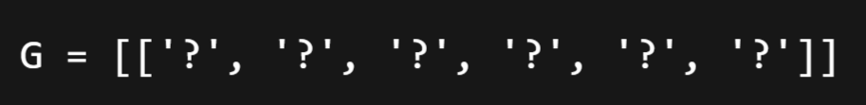
📌 5. What is G (General Boundary)?
G is the set of most general hypotheses that do not contradict any negative example.
It starts as:
(Accepts everything)
It gets specialized (made stricter) when we see negative examples.

Slide 77
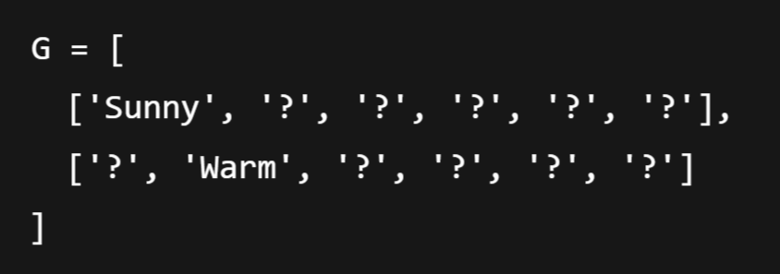
Example:
After processing some negative examples:
This means: "Do NOT enjoy sport when it’s not Sunny or not Warm."

Slide 78
📌 Key Idea
We maintain two boundaries:
S: Starts from the most specific hypothesis — '∅' (doesn’t accept anything)
G: Starts from the most general hypothesis — '?' for all attributes (accepts everything)
With each training example:
If it's positive:
Generalize S minimally to include the example.
Remove G hypotheses that do not include the example.
If it's negative:
Specialize G minimally to exclude the example.
Remove S hypotheses that include the negative example.

Slide 79
🧾 Example
Let’s say we’re learning the concept of EnjoySport. Our training dataset looks like this:
Sky | Temp | Humidity | Wind | Water | Forecast | EnjoySport
Sunny | Warm | Normal | Strong | Warm | Same | Yes
Sunny | Warm | High | Strong | Warm | Same | Yes
Rainy | Cold | High | Strong | Warm | Change | No
Sunny | Warm | High | Strong | Cool | Change | Yes

Slide 80
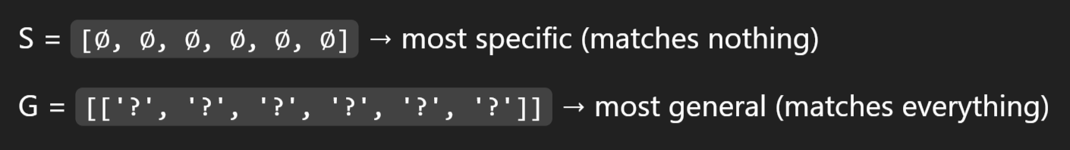
Step-by-step Execution
Initial state:
After Example 1: Positive:
S becomes this example:
G remains unchanged.

Slide 81
3. After Example 2: Positive:
S is generalized: "Normal" ≠ "High" → replace with ‘?’
G remains the same.

Slide 82
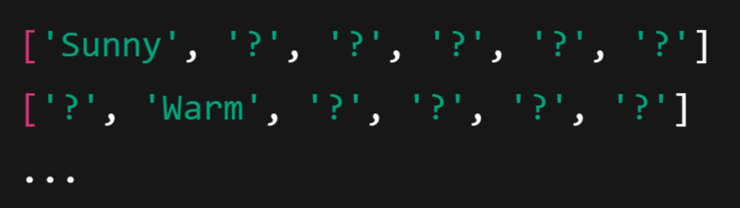
4. After Example 3: Negative:
This negative example is covered by G and must be excluded.
Specialize G (i.e., make it more specific to exclude this row but still include S):
We generate specific hypotheses like:
All combinations that do not match the negative example but are consistent with S.

Slide 83
5. After Example 4: Positive:
S is generalized again:
Water: "Warm" ≠ "Cool" → '?'
Forecast: "Same" ≠ "Change" → ‘?’
G: remove hypotheses that don't cover this positive example.

Slide 84
✅ Final Hypotheses
S = ['Sunny', 'Warm', '?', 'Strong', '?', '?']
G = a set of hypotheses that include all positive and exclude all negative examples

